Slide 1


Studies on transgenerational epigenetic inheritance of dietary factor-induced metabolic perturbation in Drosophila
Manoj Teltumbade
Supervisor: Dr. Abhay Sharma
DAC-II
16th December, 2015
Notes:
Epigenetic changes are heritable changes in gene expression, physiology or behaviour that do not involve mutations in the DNA sequence.

Slide 2
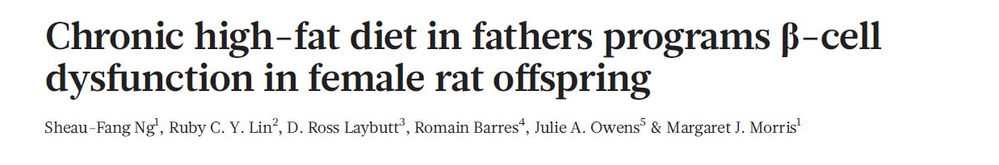
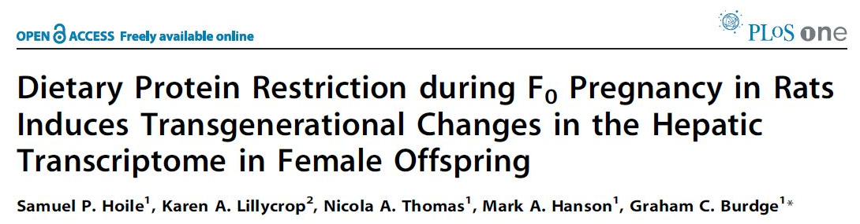
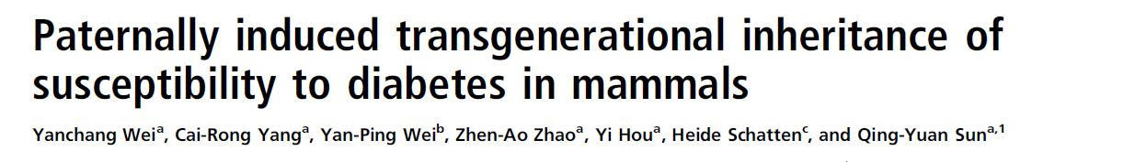
Recent studies in epigenetic inheritance
Nature. 2010 Oct
PLoS One. 2011
Proc Natl Acad Sci U S A. 2014
Notes:
There are lots of examples of recent studies published in eminent journals showing epigentic inheritance.
Father to daughters, Mother to daughters, F0 male mice to F2 progeny, 3. glucose intolerance and insulin resistance Insulin resistance was induced in male mice by feeding a high-fat diet, and impaired fasting glucose was induced by injecting these mice with a low dose of STZ,

Slide 3
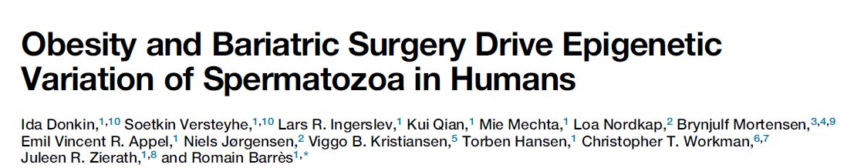
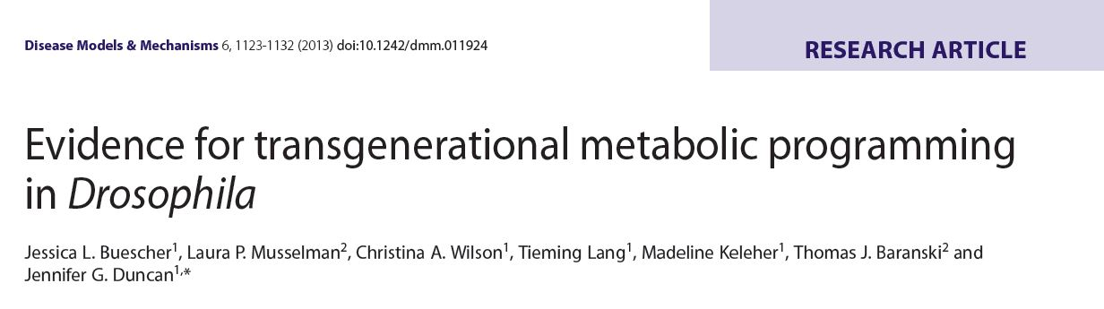
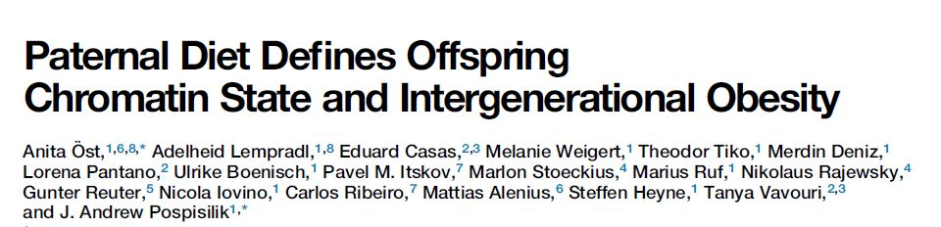
Recent studies in epigenetic inheritance
Cell Metabolism, February 9, 2016
Dis Model Mech. 2013 Sep;6(5):1123-32
Cell. 2014 Dec 4;159(6):1352-64
Notes:
1. Donkin et al. show that spermatozoa from obese men carry a distinct epigenetic signature compared to lean men, in particular at genes controlling brain development and function. The sperm methylome is dynamically remodeled after gastric-bypass-induced weight loss, notably at gene regions implicated in the central control of appetite.
2. F0 female to F2 progeny, triacylglyerides and gene expression 3. F0 males to F1 progeny, triacylglyerides and gene expression

Slide 4
Different modes of epigenetic inheritance
Soma
Environmental
factor
A
Germline
Epigenetic mark
B
C
F0
F1
F2
Notes:
There are different modes through which epigenetic information can be passed through generations. In case of A, the environmental factors changes the epigenetic marks in the germline of exposed progeny and when such marks escape through the epigenetic reprogramming then it transfers to the next generation and it may be passed to the next generation or reset during reprogramming. In case of B, environmental factor affects the somatic cells which the sends signals to the germline and such epigenetic marks are retained in subsequent generation. Third case of epigenetic inheritance can be seen in behavioural biology. In which traits like maternal care, cultural activities are continue to pass from generation to generations. Our lab is more interested in studying second mode of inheritance.

Slide 5
What are Epigenetic changes?
DNA methylation
“Heritable changes that do not involve changes in the underlying DNA sequences”
CH3
CH3CO
T G A C
A C T G
CH3CO
Histone
Modifications
CH3
mRNA
Regulatory
RNA
Notes:
Epigenetic changes are heritable changes in gene expression, physiology or behavior that do not involve mutations in the DNA sequence.

Slide 6
General schematic to test epigenetic inheritance
A
B
F0
Exposed
Normal
Exposed
F1
F2
F3

Slide 7
Proposed mechanism of Transgenerational Epigenetic Inheritance
Environmental
exposure
Evolutionary
time course
Soma
Circulation
Germline
Reprogramming
Epigenetic modification (gene expression/network, DNA methylation, histone modifications, noncoding RNA)
miRNA
Genetic
mutation
Gamete
Zygote
Post-implantation
embryo
Late fetus
Notes:
In the field of TEI, various scientists recently proposed the mechanism about how the epigenetic information can pass along from one generation to other generation. One of the proposed mechanism is environmental exposure changes the epigenetic markers in the somatic tissue, which can send signals to the germline and makes changes thereafter and pass on to the next generation.
However, there are two major concerns with this hypothesis, the epigenetics marks to carry forward to next generation, it has to escape or get protected from epigenetic resetting during two processes. 1. during gamete formation and 2. embryo differentiation.

Slide 8
Objectives
1. Investigate dietary factor induced transgenerational epigenetic inheritance of metabolic perturbations in Drosophila through male line
2. Examine genome-wide gene expression changes in the above fly model of epigenetic inheritance
3. Transgenerational analysis of networks and pathways

Slide 9

Study Design to understand Transgenerational Epigenetic Inheritance
High-Sugar(HS) Diet
Control Diet
a) Does high-sugar diet perturb metabolite
levels ?
b) Does such metabolite perturbations persist
in next generations?
a) Does high-sugar diet affect transcriptome
profile of exposed generation?
b) as well as in next generations?
How information transfers along the subsequent generations?
F1
F2
Notes:
Randomized control studies are the only way of determining what components of diet are causal; only observational studies are possible in humans because of ethics and noncompliance . On the presitigious Cochrane reviews you will only find RCTs of exercise intervention. We don’t know which diets are associated with a higher risk versus others. Past animal studies have not been comparative.
[Existing studies focus on endogenous biological function of the homologous fly gene with little reference to human disease because they start from the fly]
Unlimited supply
75% human disease genes have related sequences in D. melanogaster (defined by matches with expectation values ≤10^{–10});
Ease of Genetic manipulation

Slide 10
Study Design to understand Transgenerational Epigenetic Inheritance
High-Sugar(HS) Diet
Control Diet
a) Does high-sugar diet perturb metabolite
levels ?
b) Does such metabolite perturbation persist
in next generations?
a) Does high-sugar diet affect transcriptome
profile of exposed generation?
b) as well as in next generations?
How information transfers along the subsequent generations?
F1
F2

Slide 11
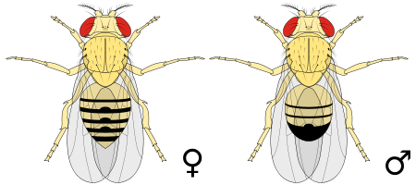
LS Diet
HS Diet
LS Diet
LS Diet
F0
LS Diet
HS Diet
F1
LS Diet
HS Diet
F2

Slide 12

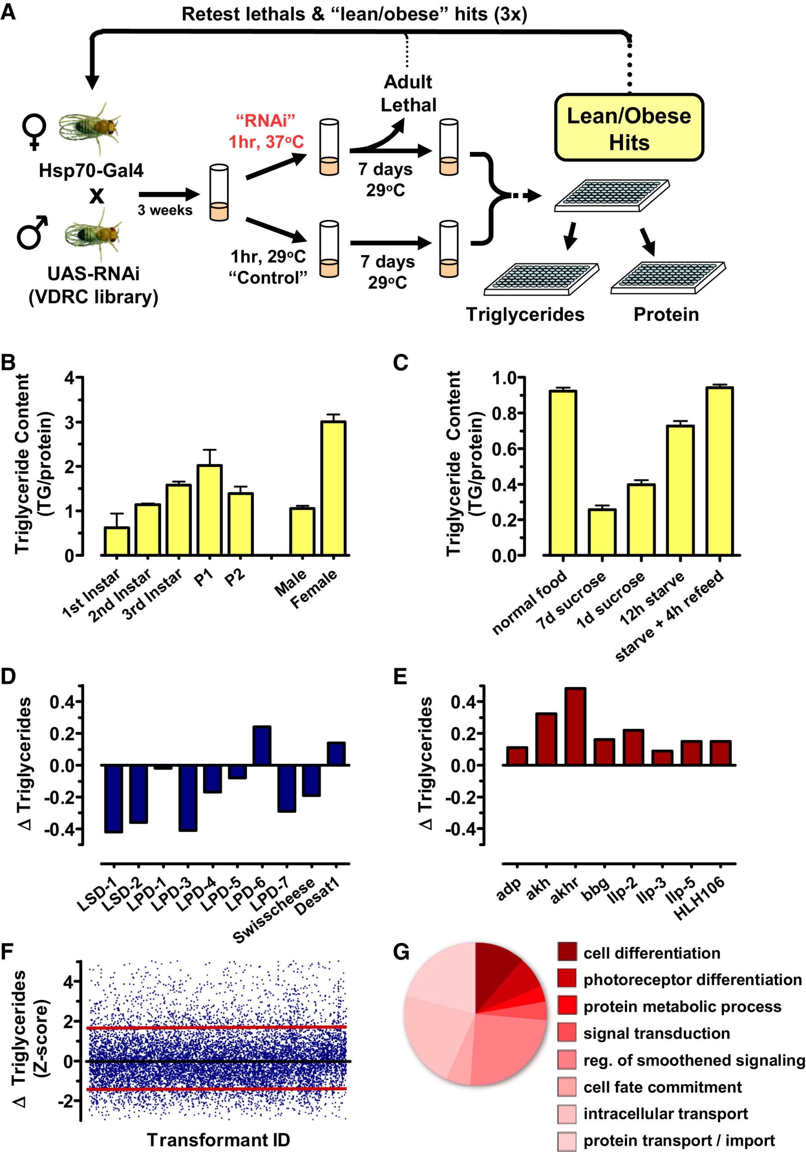
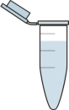
Study Design: 1a. Does high-sugar diet perturb metabolism?
2 week
Treatment
Control Diet
High-Sugar Diet
Hemolymph
Whole Body
Hemolymph
Whole Body
Free Glucose
Triacylglycerides
Protein
Weight
Free Glucose
Triacylglycerides
Protein
Weight

Slide 13
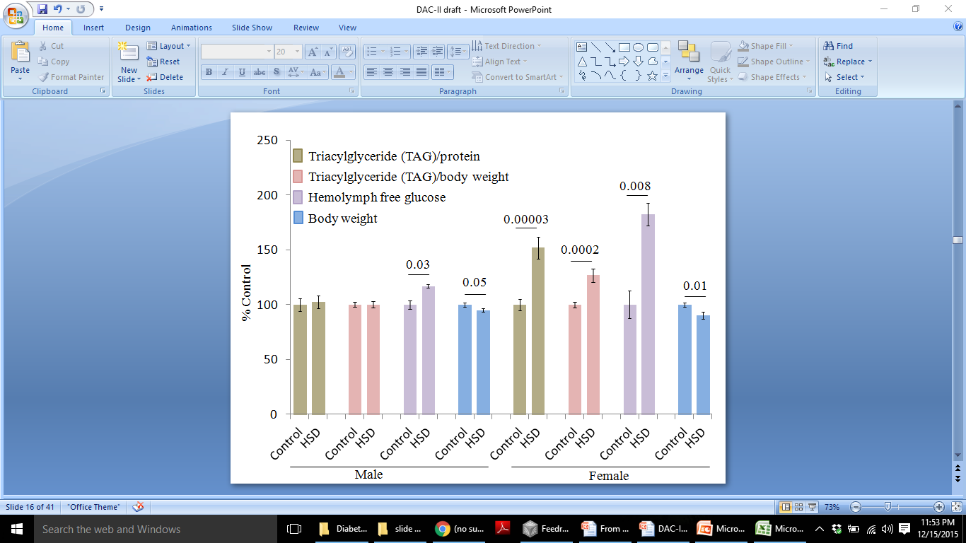
Effect of 2 week HSD on metabolite parameters in F0 flies
Conclusion 1a: High sugar diet affects the metabolite parameters in F0 flies

Slide 14
Study Design to understand Transgenerational Epigenetic Inheritance
High-Sugar(HS) Diet
Control Diet
a) Does high-sugar diet perturb metabolite
levels ?
b) Does such metabolite perturbation persist
in next generations?
a) Does high-sugar diet affect transcriptome
profile of exposed generation?
b) as well as in next generations?
How information transfers along the subsequent generations?
F1
F2

Slide 15
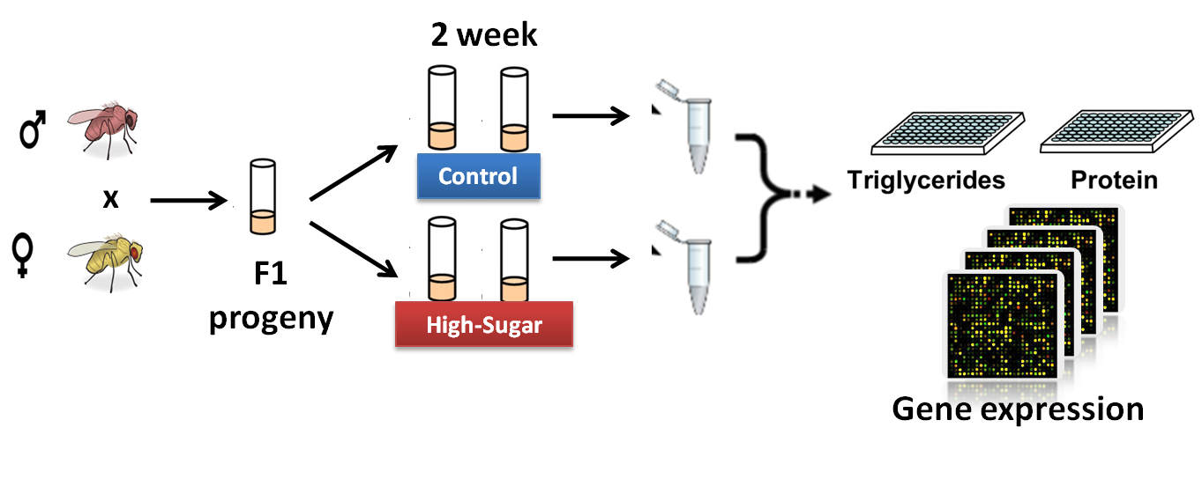
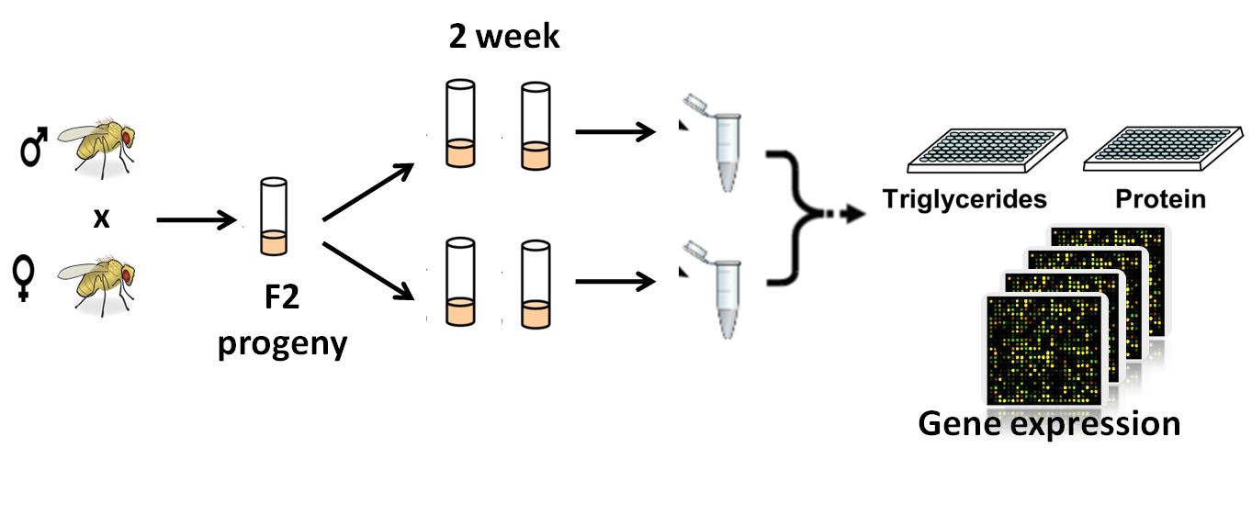

Study Design 1b:
F0 male (HSD)
A
B
F1 male
C
Control
D
High-Sugar
Notes:
To study the effect of HSD on subsequent generation, we crossed hsd fed male with normal diet female . The eggs were layed on normal medium. After eclosion, adults were treated with 2 week of treatment and sacrifised for measurement of TAG and protein level.
For generating F2 progeny, we crossed F1 male obtained through HSD fed male line and crossed with normal female. The rest of the procedure is same.
Just to stress on the point that, no F2 generation parents didn’t have exposure to HSD only their grandparent that too male line was exposed to high sugar diet.

Slide 16
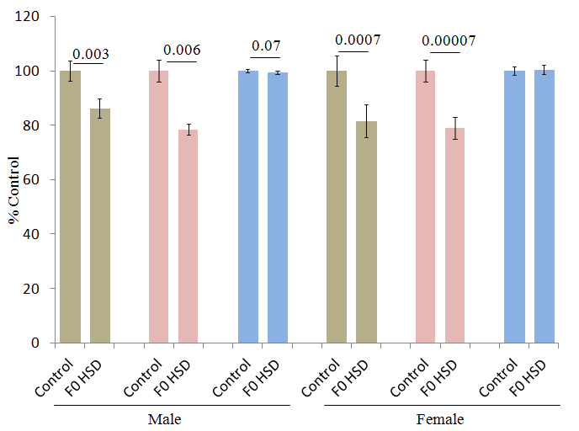
Phenotype of F1 progeny (under normal medium) derived from HSD exposed F0 males
A

Slide 17
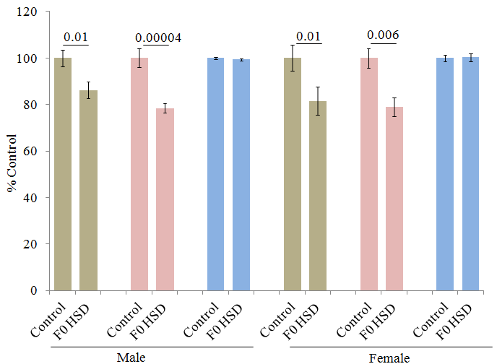
Phenotype of F1 progeny (under HSD) derived from HSD exposed F0 males
B

Slide 18
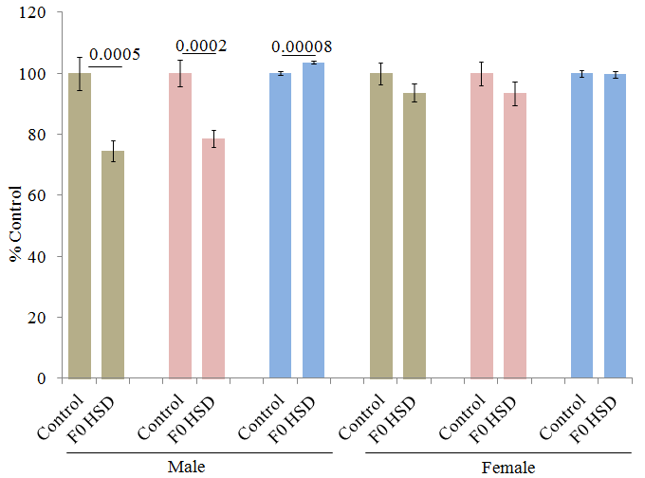
Phenotype of F2 progeny (under normal medium) derived from HSD exposed F0 males
C

Slide 19
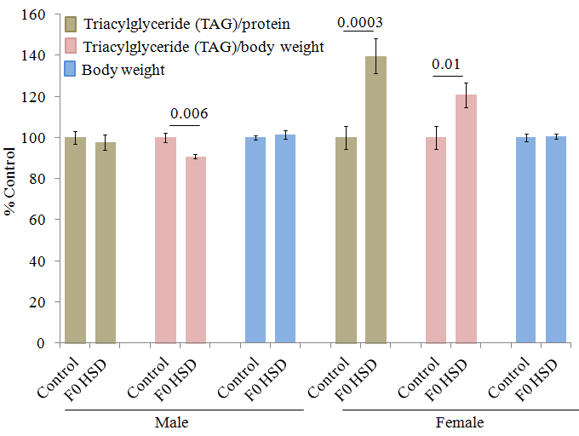
Phenotype of F2 progeny (under HSD) derived from HSD exposed F0 males
D
Conclusion 1b: Exposure of HSD in F0 males affects the metabolite phenotype in F1 and F2 generation

Slide 20
Study Design to understand Transgenerational Epigenetic Inheritance
High-Sugar(HS) Diet
Control Diet
a) Does high-sugar diet perturb metabolite
levels ?
b) Does such metabolite perturbation persist
in next generations?
a) Does high-sugar diet affect transcriptome
profile of exposed generation?
b) as well as in next generations?
How information transfers along the subsequent generations?
F1
F2

Slide 21
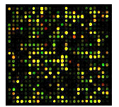
Study Design: 2a. Does high-sugar diet perturb transcriptome profile?
2 week
Treatment
Control Diet
High-Sugar Diet
RNA isolation
RNA isolation
Transcriptome Profiling
Transcriptome Profiling

Slide 22
HSD induced whole body transcriptomic alterations in F0 adults
Male
Male
FE = 1.3
p = 2.4E-09
FE = 4.4
p < E-16
Genome
Female
Genome
Female
Number of genes
Male
Female

Slide 23
Biological process & Cellular enrichment in DN genes in F0 HSD males
-log10 p value

Slide 24
Biological process & Cellular enrichment in UP genes in F0 HSD males
-log10 p value

Slide 25
Biological process & Cellular enrichment in DN genes in F0 HSD females
-log10 p value

Slide 26
Biological process & Cellular enrichment in UP genes in F0 HSD females
Conclusion 2a: Exposure of HSD in F0 progeny significantly affects transcriptomic profile with enrichment of energy metabolism and epigenetic processes.
-log10 p value

Slide 27
Human disease relevance in Drosophila model: Disease enrichment of genes
Disease
p value
Male
Loci influencing lipid levels and coronary heart disease risk in 16 European population cohorts
0.02
Genome-wide association analysis of metabolic traits in a birth cohort from a founder population
0.03
Common variants at 30 loci contribute to polygenic dyslipidemia
0.04
Loci influencing lipid levels and coronary heart disease risk in 16 European population cohorts
0.04
Female
Common variants at 30 loci contribute to polygenic dyslipidemia
0.02
Glycine encephalopathy
0.02
Mismatch repair cancer syndrome
0.004
Alzheimer disease, susceptibility to disease
0.02
Conclusion 2a: Human comparison shows gene enrichment of metabolic related diseases in HSD fed flies
Six new loci associated with body mass index highlight a neuronal influence on body weight regulation
0.02
Six new loci associated with blood low-density lipoprotein cholesterol, high-density lipoprotein cholesterol or triglycerides in humans
0.06
Notes:
The four group depending on the sex of the flies and direction of regulation was compared with the human ortholog using flyrnai.org website.
When human ortholog was submitted for analysis in Online mendelian inheritance in Man, we found enrichment of the genes which has shown correlation with the disease involving various energy related metabolism

Slide 28
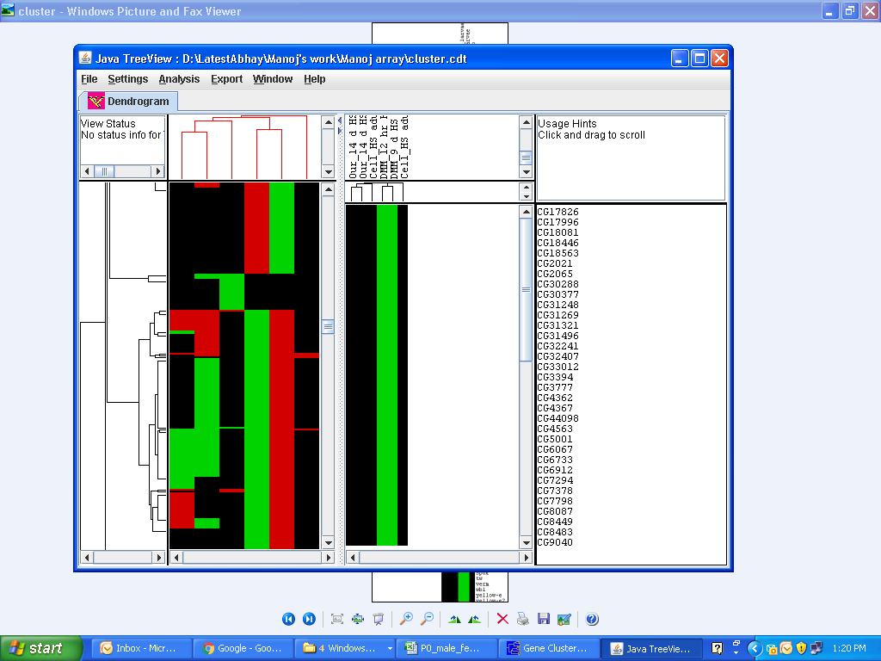
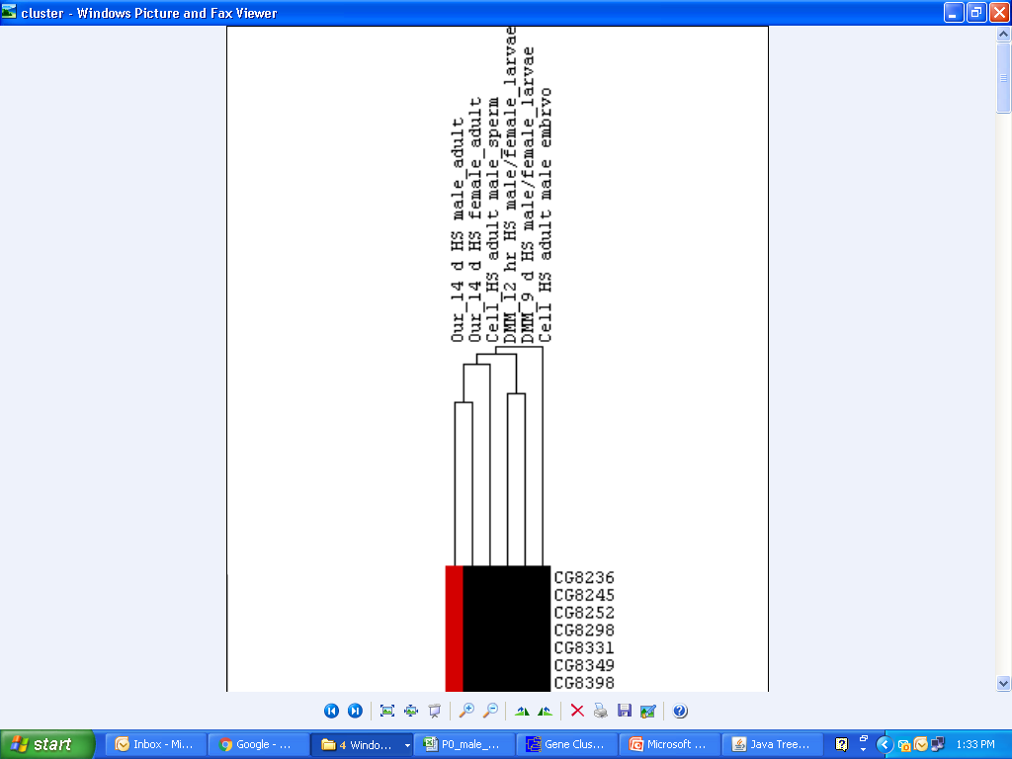
Comparing the present transcriptomic analysis with other studies reporting effect of HSD in Drosophila
Present study_14 d HS male_adult
Present study_14 d HS female_adult
Cell_2 d HS adult male_sperm
DMM_12 hr HS male/female_larvae
DMM_9 d HS male/female_larvae
Cell_2 d HS adult male_embryo
Conclusion 2a: Transcriptomic analysis shows concordance with other HSD effect studies in Drosophila
Notes:
To further validate our study results, we performed artificial cluster algorythm on the basis of up or down regulation of genes with other studies which have reported the effect of hsd on flies.

Slide 29
Conclusion
1a: High sugar diet affects the metabolite parameters in F0 flies
1b: Exposure of HSD in F0 males affects the metabolite phenotype in F1 and F2 generation
2a1: Exposure of HSD in F0 progeny significantly affects transcriptomic profile with enrichment of energy metabolism and epigenetic processes.
2a2: Human comparison shows gene enrichment of metabolic diseases in HSD fed flies
2a3: Transcriptomic analysis shows concordance with other HSD related studies reported in Drosophila

Slide 30
Study Design to understand Transgenerational Epigenetic Inheritance
High-Sugar(HS) Diet
Control Diet
a) Does high-sugar diet perturb metabolite
levels ?
b) Does such metabolite perturbation persist
in next generations?
a) Does high-sugar diet affect transcriptome
profile of exposed generation?
b) as well as in next generations?
How information transfers along the subsequent generations?
F1
F2

Slide 31
Future Plan
1. Transcriptomic analysis of F1 and F2 progeny
Transcriptomic analysis of
Hemolymph of HSD exposed F0 males
Sperm of F0 HSD males
F1 embryo obtained from: HSD male X normal female
Meta-analysis of F0 to F2 pathway and network data

Slide 32
Acknowledgements
PhD supervisor:
Dr. Abhay Sharma
DAC Committee:
Dr. Dwaipayan Bharadwaj
Dr. Shantanu Sengupta
Dr. Sridhar Sivasubbu
External Expert:
Prof. Namita Agrawal
Director:
Dr. Rajesh Gokhale
Lab Members:
Mr. Ameek Bhalla
Mr. Karunakar Pinreddy

Slide 33

Notes:
Doubt the conventional wisdom unless you can verify it with reason and experiment.

Slide 34
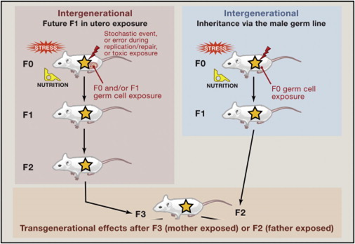
How to prove that a change is epigenetic and heritable?
Adapted from Edith Heard and Robert Martienssen. (2014) Cell.

Slide 35








 | Stage | Time | Developmental events
 | 1- 4 | 0:00 - 2:10 h | Cleavage
 | 5 | 2:10 - 2:50 h | Blastoderm
 | 6 - 7 | 2:50 - 3:10 h | Gastrulation
 | 8 - 11 | 3:10 - 7:20 h | Germ band elongation
 | 12 - 13 | 7:20 - 10:20 h | Germ band retraction
 | 14 - 15 | 10:20 - 13:00 h | Head involution and dorsal closure
 | 16 - 17 | 13:00 - 22:00 h | Differentiation

Slide 36
Introduction
Nature. 2010 Oct 21;467(7318):963-6.
Chronic high-fat diet in fathers programs β-cell dysfunction in female rat offspring.
Ng SF¹, Lin RC, Laybutt DR, Barres R, Owens JA, Morris MJ.
Father to daughters
PLoS One. 2011;6(7):e21668.
Dietary protein restriction during F0 pregnancy in rats induces transgenerational changes in the hepatic transcriptome in female offspring.
Hoile SP¹, Lillycrop KA, Thomas NA, Hanson MA, Burdge GC.
Mother to daughters
Proc Natl Acad Sci U S A. 2014 Feb 4;111(5):1873-8. doi: 10.1073/pnas.1321195111. Epub 2014 Jan 21.
Paternally induced transgenerational inheritance of susceptibility to diabetes in mammals.
Wei Y¹, Yang CR, Wei YP, Zhao ZA, Hou Y, Schatten H, Sun QY.
F0 male mice to F2 progeny, glucose intolerance and insulin resistance

Slide 37
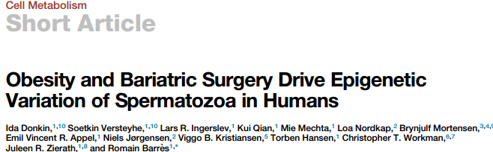
Introduction
February 9, 2016 ª2016 Elsevier Inc. http://dx.doi.org/10.1016/j.cmet.2015.11.004
Dis Model Mech. 2013 Sep;6(5):1123-32.
Evidence for transgenerational metabolic programming in Drosophila.
Buescher JL¹, Musselman LP, Wilson CA, Lang T, Keleher M, Baranski TJ, Duncan JG.
F0 female to F2 progeny, triacylglyerides and gene expression
Cell. 2014 Dec 4;159(6):1352-64. doi: 10.1016/j.cell.2014.11.005.
Paternal diet defines offspring chromatin state and intergenerational obesity.
Öst A¹, Lempradl A², Casas E³, Weigert M², Tiko T², Deniz M², Pantano L⁴, Boenisch U², Itskov PM⁵, Stoeckius M⁶, Ruf M², Rajewsky N⁶, Reuter G⁷, Iovino N², Ribeiro C⁵, Alenius M⁸, Heyne S², Vavouri T³, Pospisilik JA⁹.
F0 males to F1 progeny, triacylglyerides and gene expression

Slide 38
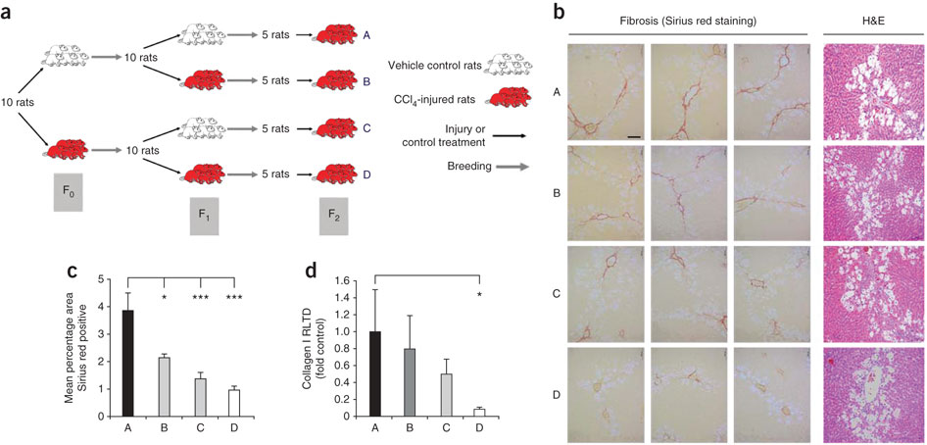
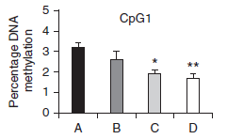
Transgenerational Epigenetic Inheritance Example I
PPARγ Promoter
Sirius red staining
Hepatic wounding
Fibrosis
Zeybel, M. et al. (2012) Multigenerational epigenetic adaptation of the hepatic wound-healing response. Nature Med.
Notes:
Adaptive liver healing in mice whose ancestors were exposed to chloroform.
The inducer—chloroform—wounds the liver of mice in F0, no exposure to chloroform takes place in F1 and when the authors again exposed the mice in F2 their livers healed faster and showed less scarring than mice whose ancestors were never exposed.

Slide 39

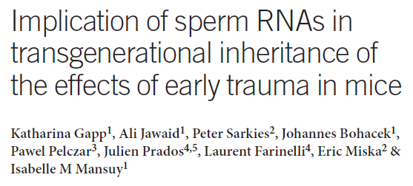
C. Cossetti et al., (2014) “Soma-to-germline transmission of RNA in mice xenografted with human tumour cells: possible transport by exosomes,” PloS one

Slide 40
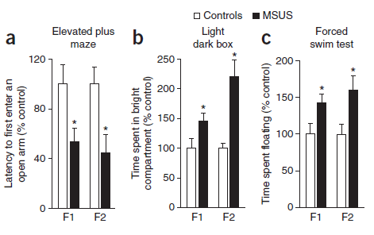
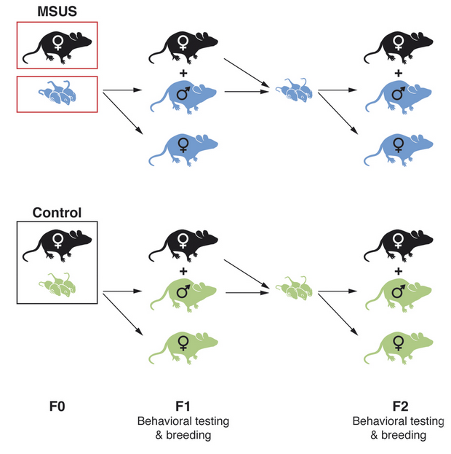
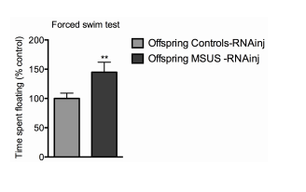
RNA-dependent processes may cause Transgenerational Inheritance
Notes:
Reduced Avoidance & Fear, altered response to aversive conditions (prefers the bright compartment), test for behaviour despair (spent more time correlates with loss of hope)

Slide 41
